Slide 1
Student Success with Machine Learning

Slide 2




Meet the Team
Andre Jacobs
Solution Analyst, Deloitte
Gilbert, AZ
Bernardo Martinez Medina
Intern, Deloitte
Guadalajara, Mexico
Juan Pablo Garcia Rosales
Intern, Deloitte
Guadalajara, Mexico
Kiran Songire
Solution Specialist, Deloitte Mechanicsburg, PA

Slide 3
Agenda
1
Introduction and Challenge
2
Our Data
3
Model Development and Evaluation
4
Wrap up and Future Work

Slide 4

With 23.3% of students leaving undergraduate programs every year,
We understand the key impact a University can have for our nation's future and how Universities can help students develop.
Graduates Make $21,000 more Annually
National Student Loan debt in 2024 is up to $1.74 Trillion
College Dropout Rates: 2024 Statistics by Race, Gender & Income | Research.com
Notes:
Tags: statement, overview, left aligned text, right aligned image, callouts

Slide 5
Goals & objectives
GOALS
DESIRED OUTCOMES
Early identification of at-risk students, allowing for early intervention strategies to help before it's too late
Improved student retention rates, which in turn will lead to better academic performance and institution reputation
Efficient allocation of resources, helping Universities make the most of the funding they receive
Drive Data Driven decision making, making decisions about intervention more justified
Be better, faster, & more cost effective
Student Focused Intelligence
Enable growth
Notes:
Tags: goals, objectives, approach, outcomes

Slide 6
What we are Building
A Binary Classification Model:
Predicting whether a student will dropout or not

Slide 7
Grouping of Attributes
Financial and Socioeconomic Information
Personal and Demographic Information
Family Background
Marital Status
Nationality
Gender
Age at Enrollment
International
Mother's Qualification​​
Father's Qualification​​
Mother's Occupation​​
Father's Occupation
Debter
Tuition Fees Up To Date
Scholarship Holder
Unemployment Rate
Inflation Rate
GDP

Slide 8
Academic Information and Performance
University Specific Information
Previous Qualifications
Admission Grade
Educational Special Needs
Curricular Units 1st Sem Credited, Enrolled, Approved,
Evaluations, Grade, Without Evaluations
Curricular Units 2nd Sem
Credited, Enrolled, Evaluations
Approved, Grade, Without Evaluations
Application Mode
Application Order
Course
Daytime/Evening Attendance
Previous Qualification Grade
Displaced

Slide 9
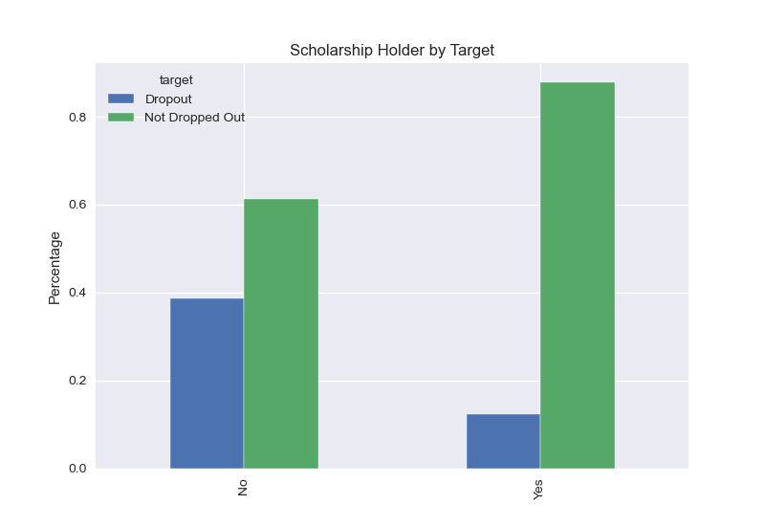
Key Data Attributes and Their Relationship with the Scholarship Holder.

Slide 10
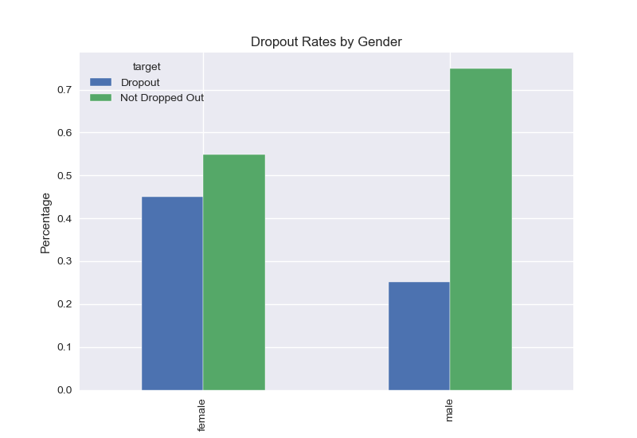
Key Data Attributes and Their Relationship with the Gender
​
​

Slide 11
Metrics that we are looking for
For our model this means
Certainly!!! when creating a machine learning model, particularly one designed to predict student dropout, it's essential to understand key performance metrics
Precision
Precision measures the proportion of predicted positives that are actually positive.
% of students predicted to drop out
Recall measures the proportion of actual positives that are correctly identified by the model
% of students who actually drop out
Recall
Accuracy measures the proportion of all predictions that are correct.
% of how many predictions were right
Accuracy

Slide 12

Choosing the models
Decision Tree
Decision Tree
XGBOOST
Random Forest
Support Vector Machine
 | Recall
True Positive | 69%
True Negative | 85%
 | Recall
True Positive | 72%
True Negative | 92%
 | Recall
True Positive | 70%
True Negative | 95%
 | Recall
True Positive | 46%
True Negative | 96%
True positive for us is predicting that from a population of students how many that will dropout from school are identified from the test.
True Negative for us is predicting how many students that won't drop out are predicted correctly
05
Options

Slide 13
Tuning the models
XGBOOST
Random Forest
Accuracy: 0.86
XGBOOST
Accuracy: 0.84
Random Forest
After tuning the model
After tuning the model
Improve
Improve
05
1%
0.5%
Options
05
Options

Slide 14

Choosing the final model
Feature | Random Forest | XGBoost
Costs | -less expensive to deploy and maintain due to its simplicity | -more costly due to its complexity, longer training times, and the need for more specialized knowledge
Scalability | - Random Forest is easier to implement and faster to train for medium size datasets (e.g., 100,000 records) | - Is better suited for very large datasets (e.g., 100,000,000 records)
Customization Complexity | - Simpler to customize. Less sensitive to hyperparameter setting (Key Parameters) | - More complex customize. Larger number of Hyperparameters (Key Parameters, Boost Parameters, Learning task parameters)
Computational Resources | -due to its ability to parallelize, can reduce cloud-based resources where you pay for compute time. | -optimizing memory usage can require additional effort and expertise, increasing costs.

Slide 15
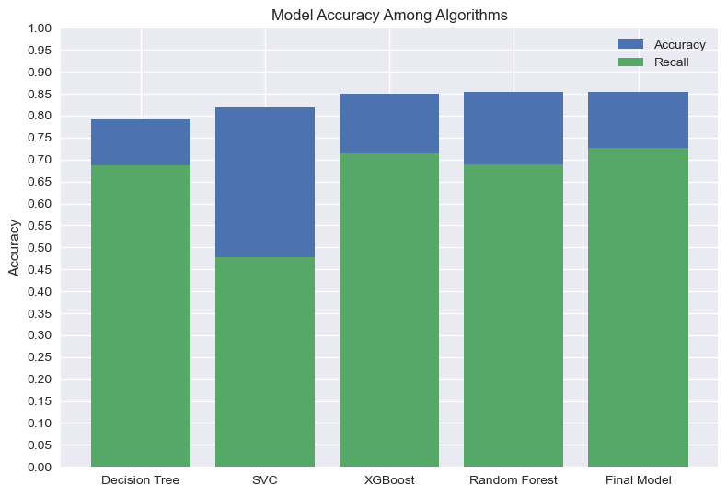
About the final model
Tunned Random Forest
Random Forest
Accuracy = 0.86
Recall = 0.73
Using 53 Features

Slide 16
Conclusion
Model Overview
Key Insights
Binary Classification Model
Utilized a Random Forest Model
Removing those features with low importance
Effective data preparation for model performance
The model predicting student outcomes
Model Performance
Implications for Institutions
Accuracy: 86%
Recall: 73%
Features Used: 53
Early Identification of at-risk students
Student retention Rates
Efficient Resource Allocation
Decision Making

Slide 17





Future Work
1
More data collection
Deploy to Cloud
3
2
Enhancing the model
4
Complementing an LMS (Canvas, Classroom)
5
Real-time Application
6
Scale to another business sectors

Slide 18
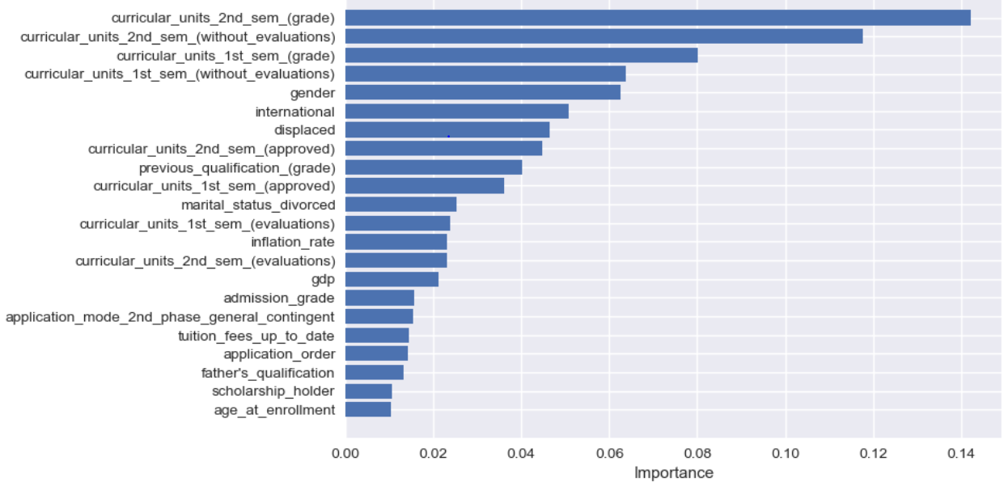
Appendix 1.1- Feature Importance

